Slide 1
How the ‘Reading Wars’ are being fought in Australia
“Great results can be achieved with small forces”
– Sun Tzu
Dr Jennifer Buckingham
Director of Strategy and Senior Research Fellow, MultiLit
Founder, Five from Five project
Find me on twitter: @buckingham_j
researchED National Conference
Chobham Academy, 7 September 2019

Slide 2
About MultiLit
MultiLit started as a research initiative of Macquarie University.
Conducts research on reading development and reading instruction through the MultiLit Research Unit.
Produces comprehensive reading programs for whole-class instruction and for small group and individual intervention.
Programs are based on scientific evidence and are intensively trialled and evaluated.
MultiLit has reading clinics that provide assessment and instructional interventions for struggling readers.
Publishes a range of books and resources including decodable readers.

Slide 3
MultiLit reading programs
MultiLit provides a suite of reading programs for instruction and intervention
PreLit: preschool literacy program
InitiaLit: whole-class instruction for Foundation to Year 2
MiniLit: small-group program for struggling readers in Year 1
MacqLit: small-group program for struggling readers in Year 3+
Reading Tutor Program: one-to-one program for struggling readers in Year 3+

Slide 4
About Five from Five
Five from Five is an initiative to bridge the gap between classroom practice and the research on effective reading instruction.
The Five from Five website presents information on research about reading development and evidence-based reading instruction and intervention.
Five from Five advocates for evidence-based reading instruction through publications, presentations, traditional and social media, and engagement with politicians, policy makers, and peak bodies.
Five from Five began as an initiative of The Centre for Independent Studies and is now supported by MultiLit.
Notes:
Not another new teaching program

Slide 5
Why are MultiLit and five from five needed?

Slide 6
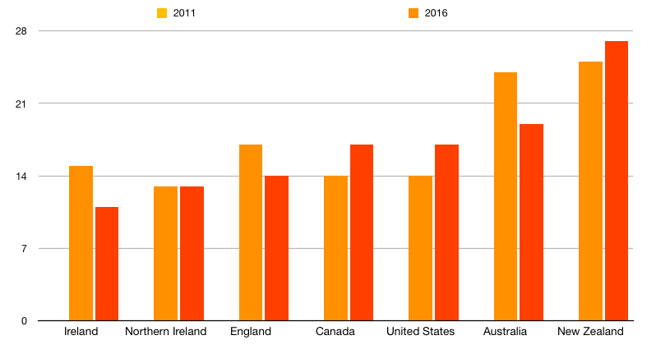
Primary school reading (Year 4): PIRLS 2011 & 2016
Percentage of students below the intermediate benchmark

Slide 7
What is evidence-based reading instruction?

Slide 8
Teaching reading is a job for experts
Republished with permission of Guilford Publications, from Scarborough (2001); permission conveyed through Copyright Clearance Center, Inc.

Slide 9
How children learn to read
Evidence-based reading instruction is based on these major models and concepts in reading acquisition:
Five essential elements of reading instruction
The Simple View of Reading
Cognitive developmental processes in beginning and skilled reading
Orthographic mapping
Self-teaching

Slide 10
Evidence-based teaching: the five keys to reading
Phonemic awareness
Phonics
Fluency
Vocabulary
Comprehension
Notes:
Accurate and efficient word reading is the foundation of reading but there is more to being proficient reader, and literate in the broader sense, than just reading individual words.
Of course skilled reading is about more than just reading individual words, t is ability is the

Slide 11
The Simple View of Reading
There is a large amount of consistent evidence that reading comprehension is almost entirely dependent on word recognition and language comprehension.
Reading Comprehension = Word Identification x Language Comprehension
Notes:
Hoover, W.A. & Tunmer, W.E. (2018). The Simple View of Reading: Three Assessments of Its Adequacy. Remedial and Special Education, 39(5), 304–312. doi: 10.1177/0741932518773154
“The Simple View of Reading continues to withstand rigorous empirical evaluation, providing a strong explanation of what reading is at its broadest level”, Hoover & Tunmer 2018

Slide 12
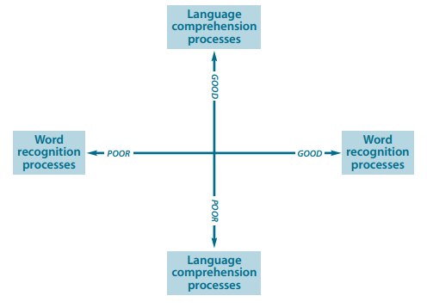
The Simple View of Reading
Reading has two essential cognitive requirements — word recognition processes and comprehension.
(Gough & Tunmer, 1986)
Reading comprehension will be impaired for anyone who has difficulty recognising the words of the text or understanding the language being read, or both.
(Hoover & Tunmer, 2018)
poor reading
good reading
The relative contributions of language comprehension and word recognition to reading comprehension changes across grades, with word recognition having a stronger relation to reading comprehension for younger than for older children.
(Lonigan et al., 2018)
poor reading
poor reading
Notes:
In a study of over 400,000 students from Year 1 to 3, it was found that among students whose decoding and vocabulary were developing normally, less than 1% displayed reading comprehension problems
(Spencer, Quinn, & Wagner, 2014)
Listening comprehension and word decoding, together with their interaction, explained 96% of the variation in early reading comprehension skills
(Lervag, Hulme, & Melby-Lervag, 2017)
Listening comprehension and word recognition provided a good estimation of Grade 3 reading comprehension, explaining around 94% of the variance
(Language and Reading Research Consortium, 2018)
Rose, J. (2006). Independent review of the teaching of early reading final report. U.K. Department for Education and Skills. Retrieved from http://dera.ioe.ac.uk/5551/2/report.pdf
Gough, P., & Tunmer, W. (1986). Decoding, reading, and reading disability. Remedial and Special Education, 7, 6–10. doi:10.1177/074193258600700104
Lonigan, J.L., Burgess, S.R., & Schatschneider, C. (2018). Examining the Simple View of Reading With Elementary School Children: Still Simple After All These Years. Remedial and Special Education, 39(5), 260– 273. doi: 10.1177/074193251876483
Hoover, W.A. & Tunmer, W.E. (2018). The Simple View of Reading: Three Assessments of Its Adequacy. Remedial and Special Education, 39(5), 304–312. doi: 10.1177/0741932518773154

Slide 13
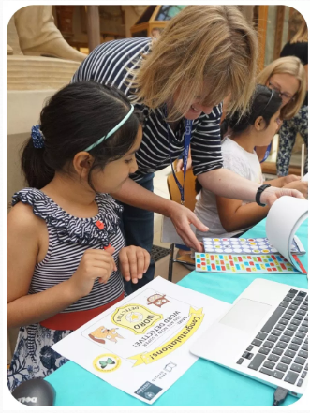
Phonics has a crucial role in learning to read
“There is clear consensus and abundant evidence that in alphabetic languages, phonological decoding is at the core of learning to read words”
Professor Kate Nation, ReadOxford
Notes:
Image: ReadOxford www.readoxford.org

Slide 14
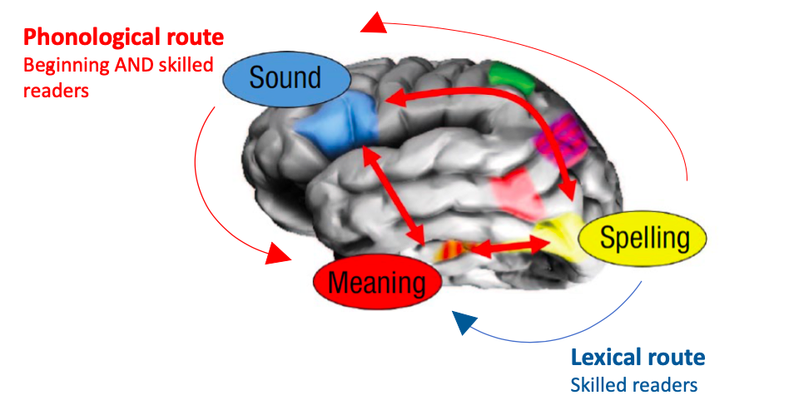
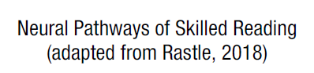
Beginning readers are different to skilled readers
Notes:
Written language is a new skill as far as the evolution of the brain is concerned. It is not naturally acquired like spoken language.
There is no single ‘reading’ area of the brain. Making sense of the printed word requires making connections between regions of the brain that were originally devoted to other processes.
Whole language teaching assumes that learning to read involves switching on a reading centre in the brain. It’s not that simple. A complex set of neuronal circuitry needs to be deliberately created.

Slide 15
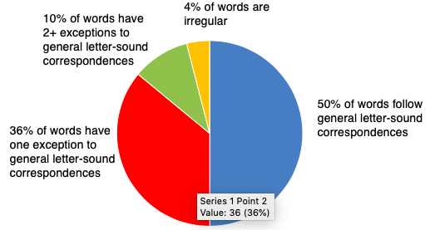
Getting from the phonological to the lexical route:
Orthographic mapping
When we have seen and read a word many times, it is stored in long term memory as a unique letter string and can be read almost instantly. This process is referred to as orthographic mapping.
It is not the same as learning words as ‘sight words’, where words are memorised as logographs (word shapes) without reference to the grapheme-phoneme properties of the word.
Notes:
Ehri, L. (2013). Orthographic mapping in the acquisition of sight word reading, spelling memory, and vocabulary learning, Scientific Studies of Reading, 18, 5-21.

Slide 16
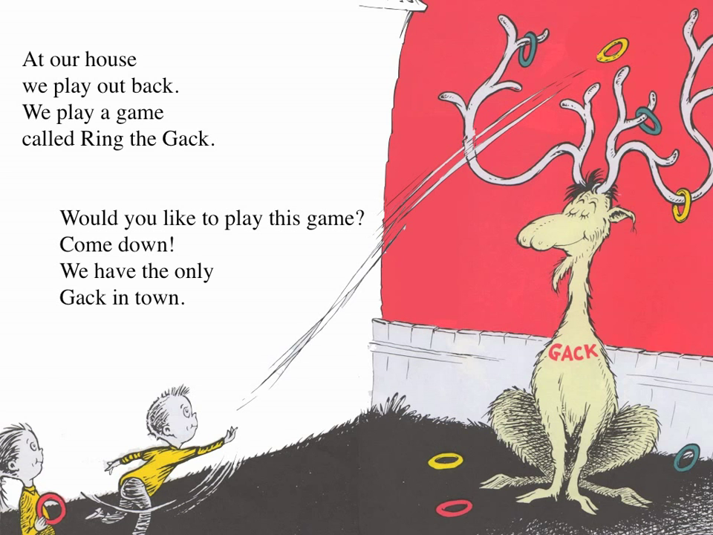
The self-teaching hypothesis
Once learners have established their knowledge of grapheme-phoneme correspondences and segmenting and blending, they begin to apply this knowledge to new and novel words.
Proficient decoders can do this because the reader is able to pay attention to the order and identity of letters and how they map onto the spoken form of the word.
Each time a reader is exposed to a new word when reading they are able to use their knowledge of phonics to work out how to say the word and add it to their orthographic memory.
Notes:
Share, D.L. (1995). Phonological recoding and self-teaching: sine qua non of reading acquisition. Cognition, 55, 151-218.
Cunningham, A.E., Perry, K.E., Stanovich, K.E. & Share, D. (2002). Orthographic learning during reading: examining the role of self-teaching, Journal of Experimental Child Psychology, 82, 185-199
Tucker, R., Castles, A., Laroche, A., & Deacon, H. (2016). The nature of orthographic learning in self-teaching: Testing the extent of transfer. Journal of Experimental Child Psychology, 145, 79-94

Slide 17
“What is often lacking in initial reading instruction, in particular, is effective, specific instruction in what is known as synthetic phonics; how to relate letters to sounds and to blend letter sounds into words.”
“Phonics instruction provides a self-teaching mechanism by which children can teach themselves an increasing number of new words, initially by sounding them out. With sufficient repetition, and this varies for each child, these words are learned as sight words; they do not subsequently have to be sounded out each time they are encountered in text.”
- Emeritus Professor Kevin Wheldall

Slide 18
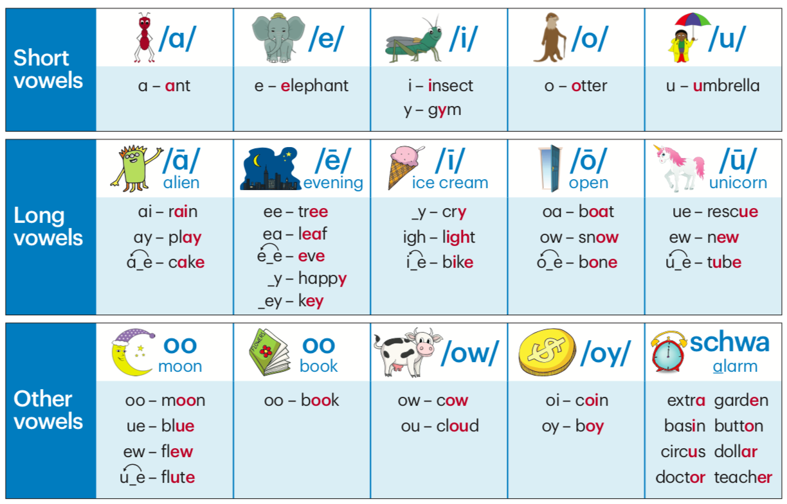
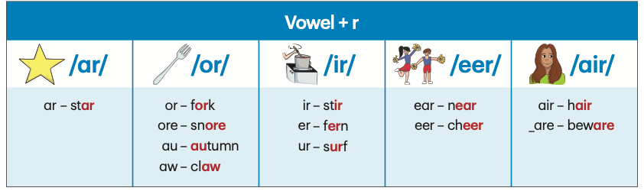
What is synthetic phonics?
Synthetic means building words from the smallest sub-word units – graphemes and phonemes.
Grapheme-phoneme correspondences are taught in a carefully developed sequence from simple to complex
Blending and segmenting is introduced as soon as a few GPCs are learned
The simple code can be taught in a few months and the extended code in two to three years
Notes:
Image: Reading Doctor www.readingdoctor.com.au

Slide 19
Synthetic phonics is strongly aligned to the scientific evidence of how children learn to read
Synthetic phonics builds the necessary neurological connections between the visual (grapheme) and phonological (phoneme) characteristics of words.
It thereby develops the phonological route to reading – the initial and essential cognitive process for beginning readers
It establishes these connections quickly and firmly, moving this information to long term memory and minimising cognitive load
The pace can be adjusted to the learning needs of individual children
Learning to decode ‘through the word’ facilitates orthographic mapping, leading to skilled and proficient reading.
Blending and segmenting of GPCs is introduced early to allow cumulative introduction of new GPCs, allowing the decoding of new words and facilitating self-teaching.
Successful self-teaching using phonic knowledge accelerates the acquisition of ‘sight words’ and development of the lexical route of the DRC model – leading to fluent and proficient reading.

Slide 20
The Australian context

Slide 21
Open letter to the federal minister for education
In 2004, a group of eminent reading researchers, linguists, educational psychologists and cognitive scientists wrote an open letter to then federal education minister, Brendan Nelson.
This letter renewed the debate over reading instruction and lead to a national inquiry into the teaching of literacy.
“We would like particularly to draw to your attention to the continuing discrepancy between the model of reading development that forms the basis for most of our current school curricula and teaching methods, and the model of reading development that is emerging as a result ofthe research into reading that has been undertaken over the past twenty to thirty years.”

Slide 22
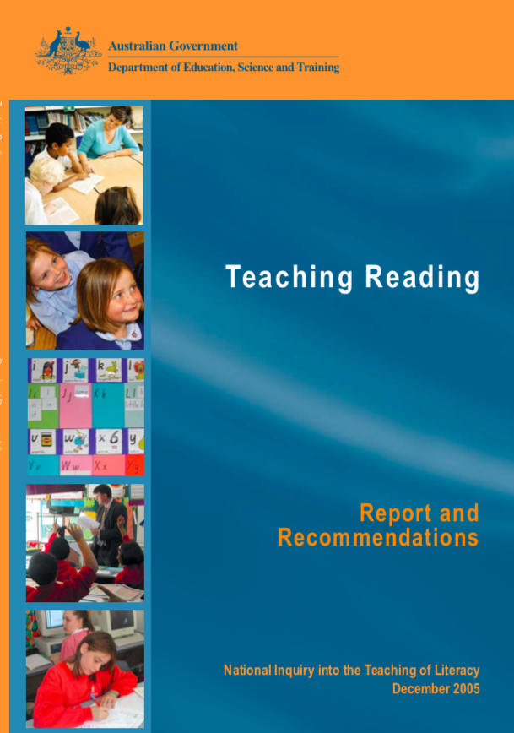
The Rowe Report (2005)
“The committee recommends that teachers provide systematic, direct and explicit phonics instruction so that children master the essential alphabetic code-breaking skills required for foundational reading proficiency.
Equally, that teachers provide an integrated approach to reading that supports the development of oral language, vocabulary, grammar, reading fluency, comprehension and the literacies of new technologies.”

Slide 23
“Nothing has actually happened since the inquiry because Higher education providers of education and those who provide ongoing professional development of teachers, with a few exceptions, are still puddling around in postmodernist claptrap about how children learn to read.”
- Professor Ken Rowe in The Age (8 Sept 2008)
Notes:
Feb 2009

Slide 24
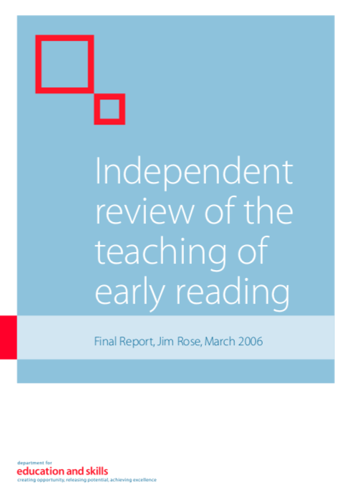
The Rose Report (2006)
“High quality, systematic phonic work as defined by the review should be taught discretely.”
“Phonic work should be set within a broad and rich language curriculum that takes full account of developing the four interdependent strands of language: speaking, listening, reading and writing and enlarging children’s stock of words.”

Slide 25
Australian Curriculum was introduced in 2012
English: Foundation to Year 2
Language, Literacy and Literature (Receptive and Productive modes)
Content descriptions and achievement standards relating to phonemic awareness, phonics, and word reading
Comparison of 2012 (original document) and 2015 (current version)

Slide 26
Foundation
2012
Know that spoken sounds and words can be written down using letters of the alphabet and how to write some high frequency sight words and known words. | Know how to use onset and rime to spell words. | Recognise rhymes, syllables and sounds (phonemes) in spoken words. | Recognise the letters of the alphabet and know there are lower and upper case letters. | Produce some lower case and upper case letters using learned letter formations.
2015 (current)
Recognise and generate rhyming words, alliteration patterns, syllables and sounds (phonemes) in spoken words. | Recognise and name all upper and lower case letters (graphemes) and know the most common sound that each letter represents. | Understand how to use knowledge of letters and sounds, including onset and rime to spell words. | Know how to read and write some high-frequency words and other familiar words. | Understand that words are units of meaning and can be made of more than one meaningful part. | Segment sentences into individual words and orally blend and segment onset and rime in single syllable spoken words, and isolate, blend and manipulate phonemes in single syllable words. | Write consonant-vowel-consonant (CVC) words by representing some sounds with the appropriate letters, and blend sounds associated with letters when reading CVC words. | Read decodable and predictable texts, practising phrasing and fluency, and monitor meaning using concepts about print and emerging contextual, semantic, grammatical and phonic knowledge.

Slide 27
Year 1
2012
Know that regular one syllable words are made up of letters and common letter clusters that correspond to the sounds heard, and how to use visual memory to write high frequency words. | Manipulate sounds in spoken words including phoneme deletion and substitution. | Recognise sound-letter matches including common vowel and consonant digraphs and consonant blends. | Understand the variability of sound-letter matches. | Recognise and know how to use morphemes in word families. | Combining knowledge of context, meaning, grammar and phonics to decode text.
2015 (current)
Manipulate phonemes in spoken words by addition, deletion and substitution of initial, medial and final phonemes to generate new words. | Use short vowels, common long vowels, consonant digraphs and consonant blends when writing, and blend these to read single syllable words. | Understand that a letter can represent more than one sound and that a syllable must contain a vowel sound. | Understand how to spell one and two syllable words with common letter patterns. | Recognise and know how to use simple grammatical morphemes to create word families. | Use visual memory to read and write high-frequency words. | Segment consonant blends or clusters into separate phonemes at the beginnings and ends of one syllable words. | Read decodable and predictable texts using developing phrasing, fluency, contextual, semantic, grammatical and phonic knowledge and emerging text processing strategies, for example prediction, monitoring meaning and re-reading

Slide 28
Year 2
2012
Understand how to use digraphs, long vowels, blends and silent letters to spell words, and use morphemes and syllabification to break up simple words and use visual memory to write irregular words. | Recognise most sound-letter matches including silent letters, vowel/consonant digraphs and many less common sound-letter combinations
2015 (current)
Orally manipulate more complex sounds in spoken words through knowledge of blending and segmenting sounds, phoneme deletion and substitution in combination with use of letters in reading and writing. | Understand how to use knowledge of digraphs, long vowels, blends and silent letters to spell one and two syllable words including some compound words. | Build morphemic word families using knowledge of prefixes and suffixes. | Use knowledge of letter patterns and morphemes to read and write high-frequency words and words whose spelling is not predictable from their sounds. | Use most letter-sound matches including vowel digraphs, less common long vowel patterns, letter clusters and silent letters when reading and writing words of one or more syllable. | Understand that a sound can be represented by various letter combinations. | Read less predictable texts with phrasing and fluency by combining contextual, semantic, grammatical and phonic knowledge using text processing strategies, for example monitoring meaning, predicting, rereading and self-correcting.

Slide 29
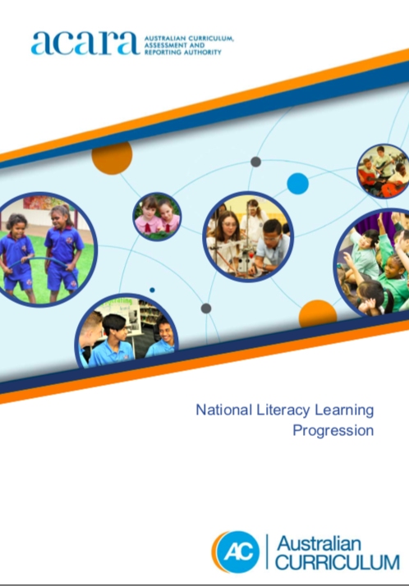
Literacy Learning Progressions (2018)
The National Literacy Learning Progression helps teachers to develop fine-grain understandings of student literacy development in the Australian Curriculum: English, especially in the early years. The progression amplifies the literacy skills in the Australian Curriculum: English, particularly in the Language and Literacy strands.
The progression is particularly useful in guiding teachers to support students whose literacy development is above or below the age-equivalent curriculum expectations of the Australian Curriculum: English. The progression has not been designed as a checklist and does not replace the Australian Curriculum: English.

Slide 30
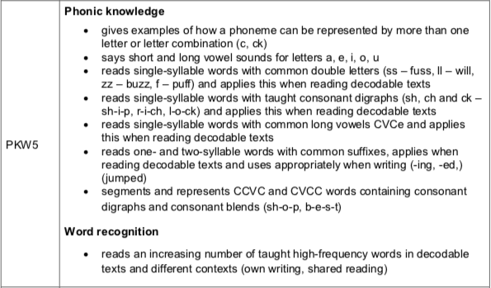
Example: Phonic knowledge and word recognition

Slide 31



Australian Curriculum: definition of ‘decode’
2012 original definition:
A process of working out a meaning of words in a text. In decoding, readers draw on contextual, vocabulary, grammatical and phonic knowledge.
Readers who decode effectively combine these forms of knowledge fluently and automatically, and self-correct using meaning to recognise when they make an error.
2019 revised definition:
A process of efficient word recognition in which readers use knowledge of the relationship between letters and sounds to work out how to say and read written words.

Slide 32

NSW Centre for Education Statistics and Evaluation (2017)
“There is a significant amount of research that has been conducted into effective reading instruction. The evidence identifies five essential and interconnected components of effective, evidence- based reading instruction: phonemic awareness, phonics, fluency, vocabulary, and comprehension. All these elements are essential for the early stages of literacy learning. To be most successful, these skills must be taught explicitly, sequentially and systematically.
All teachers need to be equipped with an understanding of evidence-based reading instruction and the ability to implement this in the classroom. Currently, there appear to be some discrepancies between the research as to ‘what works’, and the teaching practices that underpin many ITE programs. Teaching programs should cover the five components of effective reading instruction, as well as the use of assessments to identify and implement appropriate reading strategies.”

Slide 33



NSW Centre for Education Statistics and Evaluation (2018-19)
2018
2019
2019

Slide 34
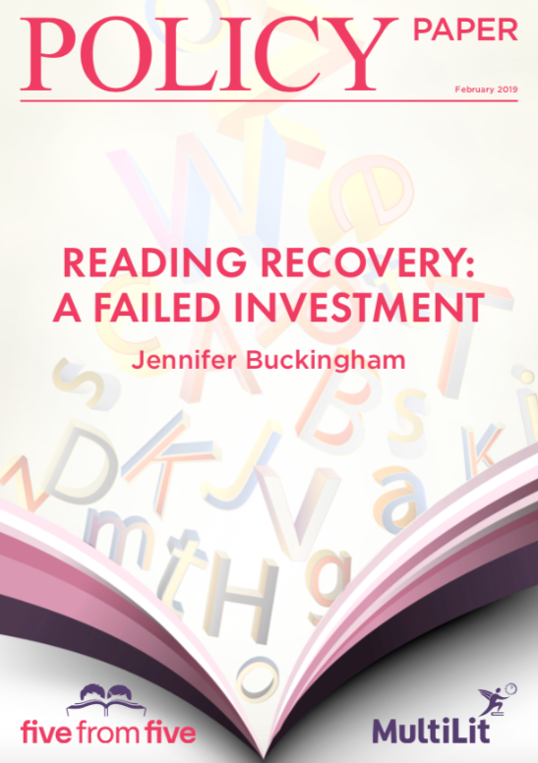
Reading Recovery is no longer a government-funded program in Australia
Every Child A Reader Ten Year Follow Up UNPUBLISHED (n = 271)
Compared three groups of students
RR: Students in RR schools who did RR in Year 1
RRC: Students in RR schools who did not do RR
CC: Students in non-RR schools (comparison schools)
Ten years later… RR > CC RRC > CC RR = RRC
This suggests that there was something about the RR schools that was associated with higher achievement in Year 6 rather than participation in RR itself.
Every Child A Reader Ten Year Follow Up PUBLISHED (n = 222)
Ten years later… RR > CC
BUT … where is the RRC group? It was dropped from the published 10 Year Follow Up study without explanation, allowing the authors to make grand claims about the impact of RR.
Notes:
CESE evaluation (n = 20,000+) in Australia
Compared children who had done Reading Recovery in Year 1 with a matched group of children who had not.
Children who had done Reading Recovery had on average significantly lower scores on the NAPLAN reading test in Year 3.
i3 Scale Up (n = 630) in USA
Compared children who had done RR in Year 1 with a matched group of children who had not.
There was no significant difference in Year 3 reading scores on the Iowa Basic Skills test between the groups

Slide 35
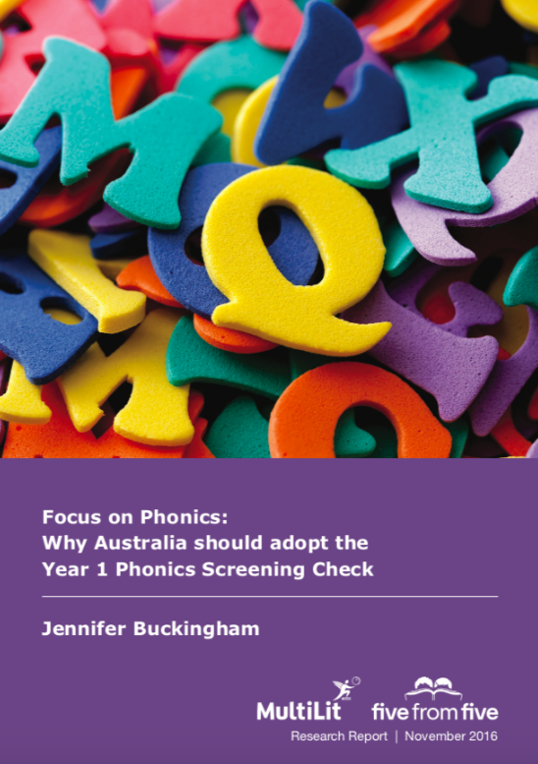
Year 1 Phonics Screening Check
2016 Focus on Phonics
2017 Quality Schools Quality Outcomes
2017 Expert Advisory Group for Fed Govt
2017 South Australian trial 2017
2018 South Australian state-wide roll out
2018 Queensland Catholic Education trial
2019 South Australia Catholic and independent schools opt in
2020 NSW trial

Slide 36
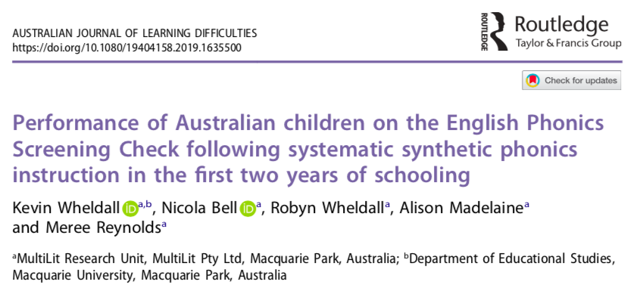
Year 1 Phonics Screening Check study
151 students in three NSW primary schools
1 year + 3 terms of InitiaLit program prior to the Check
Notes:
The evaluation of the trial in 2017 found that
34% favoured a synthetic phonics approach “most” of the time
27% of teachers reported using an analytic phonics approach “most” of the time
15% of teachers reported using an incidental phonics “most” of the time

Slide 37
Year 1 Phonics Screening Check study
Mean score = 33/40 (real words = 16.58; pseudo words = 16.51)
% achieving 32+ = 73%
% achieving 28+ = 82%
Compared to 43% of students in SA who achieved 28/40 in 2018
The ‘stopping rule’ that was used in the SA trial was not found to affect the scores.
No spike in scores was evident
Notes:
The evaluation of the trial in 2017 found that
34% favoured a synthetic phonics approach “most” of the time
27% of teachers reported using an analytic phonics approach “most” of the time
15% of teachers reported using an incidental phonics “most” of the time

Slide 38

Evidence for Learning
Based on Education Endowment Fund model
- Teaching and Learning Toolkit
- Learning Impact Fund
Notes:
For example, MiniLit trial
Problems: rigidity of the protocols (primary outcome measure + ITT analysis); months of learning metric

Slide 39
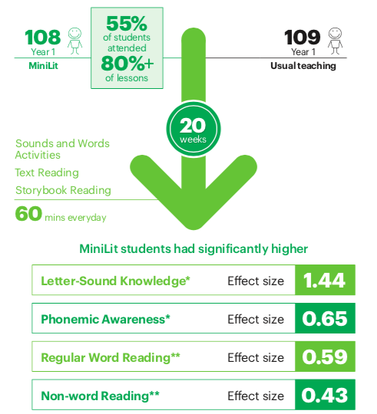
MiniLit Learning Impact Fund Evaluation
Notes:
The evaluation found strong significant positive results for MiniLit on the foundational reading skills it targets.
However the independent evaluation report and the Evidence for Learning website present the findings from a test that was determined to not be an appropriate measure for the study after the study commenced. It is understandable that researchers cannot change horses part way through the race, as it were, but adherence to the EEF protocols meant that the evaluation report gave the impression that MiniLit was not effective. This study was a special case where the original primary outcome measure should and could justifiably been replaced by one of the secondary outcome measures, as these classifications are irrelevant anyway, and one of the secondary outcome measures is the companion test to the primary outcome measure.

Slide 40
Indicators of progress

Slide 41
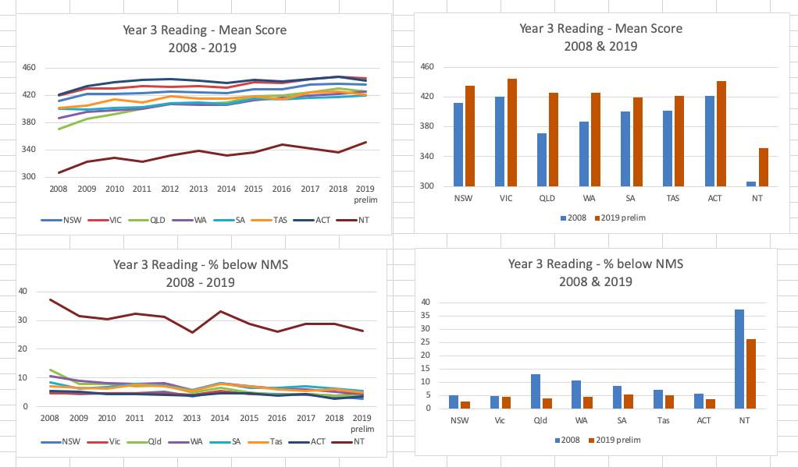
NAPLAN 2008 - 2019: Mean scores

Slide 42
NAPLAN 2008 - 2019: % below minimum standard

Slide 43
Obstacles to improvement

Slide 44
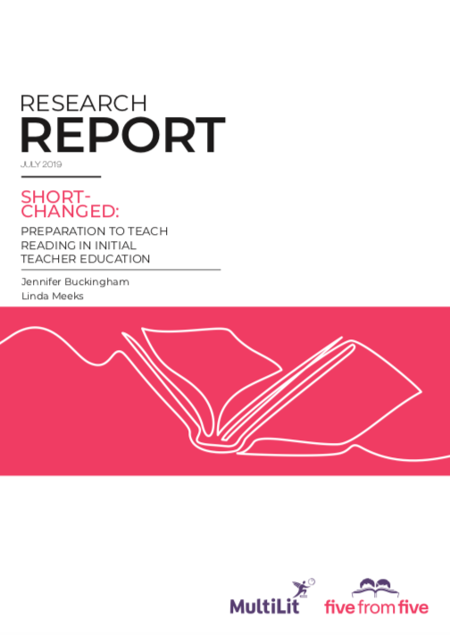
Initial Teacher Education
116 core literacy units in 66 undergraduate degrees in 38 universities.
Course outlines:
Only 4% of the literacy units had a specific focus on early reading instruction or early literacy; that is, how to teach beginning readers in the first few years of school.
In 70% of literacy units, none of the five essential elements of effective evidence-based reading instruction were mentioned in the unit outlines. All five essential elements were referred to in only 6% of literacy unit outlines.
None of the unit outlines contained references to the Simple View of Reading. The specific model or theory mentioned most frequently in the unit outlines was the Four Resources / Four Roles of a Reader model, with eight mentions. The sociocultural model or view of reading was referred to nine times.
Notes:
Persistent and widespread concerns about the preparation of teachers to teach reading come from three sources: reviews and inquiries into the quality of initial teacher education; research surveys of preservice and graduate teacher knowledge about language and teaching, and their perceptions of their readiness to teach reading; and testimonies from preservice and graduate teachers.
This report adds to the evidence supporting the need for urgent and dramatic improvement in initial teacher education by looking at the extent to which literacy units in undergraduate initial teacher education courses provide evidence-based information on how children learn to read; and the most effective ways to teach them. It does this by examining the content of 116 literacy units in 66 degrees in 38 universities.

Slide 45
Initial Teacher Education
116 core literacy units in 66 undergraduate degrees in 38 universities.
Lecturer/course coordinator qualifications and expertise
15% of the lecturers and unit coordinators that could be identified had specific expertise in early reading instruction or literacy, most with a particular interest in early literacy development among Indigenous and other children from non-English speaking backgrounds.
55% had research interests and expertise in other aspects of literacy, most often digital and multi-modal literacies.
30% of the literacy lecturers or unit coordinators had research interests and expertise in areas other than literacy, such as maths or music.

Slide 46
Initial Teacher Education
116 core literacy units in 66 undergraduate degrees in 38 universities.
Six most commonly prescribed text books:
None contained sufficiently accurate and detailed content that would allow graduate teachers to use effective, evidence-based instruction, and many contained information that was inadequate and/or misleading.
Most of the textbooks with phonics content explicitly endorse the ‘three-cueing system’, and all textbooks promote it implicitly.
Two of the six books referred to the Simple View of Reading but devoted less than a page to it. All endorsed the Four Resources Model.
Only one book referred to dyslexia at all, and the content is brief.
Notes:
Dyslexia is a serious learning difficulty
that is estimated to affect approximately 5% of students. All teachers of reading should be aware of the indicators of dyslexia in a child who is struggling with reading so they can refer them for specialist diagnosis and intervention as early as possible.

Slide 47
  Seely Flint, A., Kitson, L., Lowe, K., & Shaw, K. (2014).
  Literacy in Australia: Pedagogies for engagement.
  Milton, Australia: Wiley. (p. 232)
  “Use onset and reading ahead to gather more information. It is not uncommon for children to say ‘I read ahead and thought it was pony but when I took another look, I noticed it started with “s” – it must be stallion’.”
  “Sound out a word by elongating its sounds. This is a familiar but often ineffective strategy, known as ‘sounding out’. This strategy encourages readers to stretch out the sounds from left to right, noticing all the sounds in the word. As a strategy it is not all that predictable because of the large variation in the way letters and words are sounded. Using the first letter and gaining meaning from the sentence is a much more predictable strategy.”
Notes:
This is an example of the sort of thing that Emily Hanford was talking about in her latest radio doco. Multiple cueing strategies are widely used and still promoted by universities and professional associations.

Slide 48
Conclusions

Slide 49
The research and teaching community knows a lot about how children learn to read and how best to teach them.
Progress is toward implementation is slow but real – both in schools and in policy.
Progress is patchy in Australia: Federation is a blessing and a curse.
Subject professional associations and teacher unions are impeding progress by rejecting scientific research evidence on reading instruction.
Independent universities and academic freedom are important but present a barrier to improvement.

Slide 50

MultiLit
Comprehensive whole class and intervention reading programs based on 20+ years of scientific and applied research and development
www.multilit.com
@MultiLitmedia
five from five
Free information and resources for evidence-based reading instruction
www.fivefromfive.org.au
@fivefromfive
Find me on twitter: @buckingham_j

